Slide 1


Computer Science in the Real World
Russell Feldhausen (@russfeld) Have a Byte 2019
Notes:
A little over a year ago, I was contacted by Dr. DeLoach, the computer science department head, to help solve an interesting problem...

Slide 2
The Problem
How can we provide CS courses to a rapidly growing number of non-CS majors using limited resources?
Notes:
Classes are too full, few complete minor
Growing demand for CS skills
<quote>
Can’t just hire more faculty

Slide 3

If you wish to make an apple pie from scratch, you must first invent the universe.
Carl Sagan
Notes:
Think outside the box
<quote>
Rethink education, challenge assumptions
SIGCSE session – rebuild education from the ground up after catastrophe

Slide 4
The Ideal Form of Education
Source: https://giphy.com/gifs/dreamworks-lets-do-this-kung-fu-panda-master-shifu-QxZ0nbcVgMlPlnfZos
Notes:
Ideal form – one student, one master
apprenticeships

Slide 5
A Scalability Problem
Computer Scientists like those!
Source: https://giphy.com/gifs/the-simpsons-class-dont-care-W1VdPHo8Ft3Es
Notes:
How to teach more students?
Maximize educational quality while teaching more students
I love scalability problems

Slide 6
The Traditional Approach
Few Students
More Students
Small Lessons
Instant Feedback
Customized Curricula
Develop & Engage
Individual Skills
Large Classes
Turn In & Wait
Published Textbooks
Lecture & Grade
Credit Hours
Notes:
Traditional approach – few students, quality education
Scale up – becomes large classes, inflexible, too much time lecturing and grading

Slide 7

Online Learning?
Source: https://giphy.com/gifs/uviccampuslife-classroom-lecture-uvic-piZ2mYa0R9zzBpT9yb
Notes:
Apply that to online learning – poor quality
Hybrid – students feel like second class citizens

Slide 8
The Online Approach
Few Students
More Students
Small Lessons
Instant Feedback
Customized Curricula
Develop & Engage
Individual Skills
Small Lessons
Instant Feedback
Customized Curricula
Develop & Engage
Individual Skills
Notes:
Can we take the things that make education on the small scale so good, and scale it up so that it works online using technology?

Slide 9
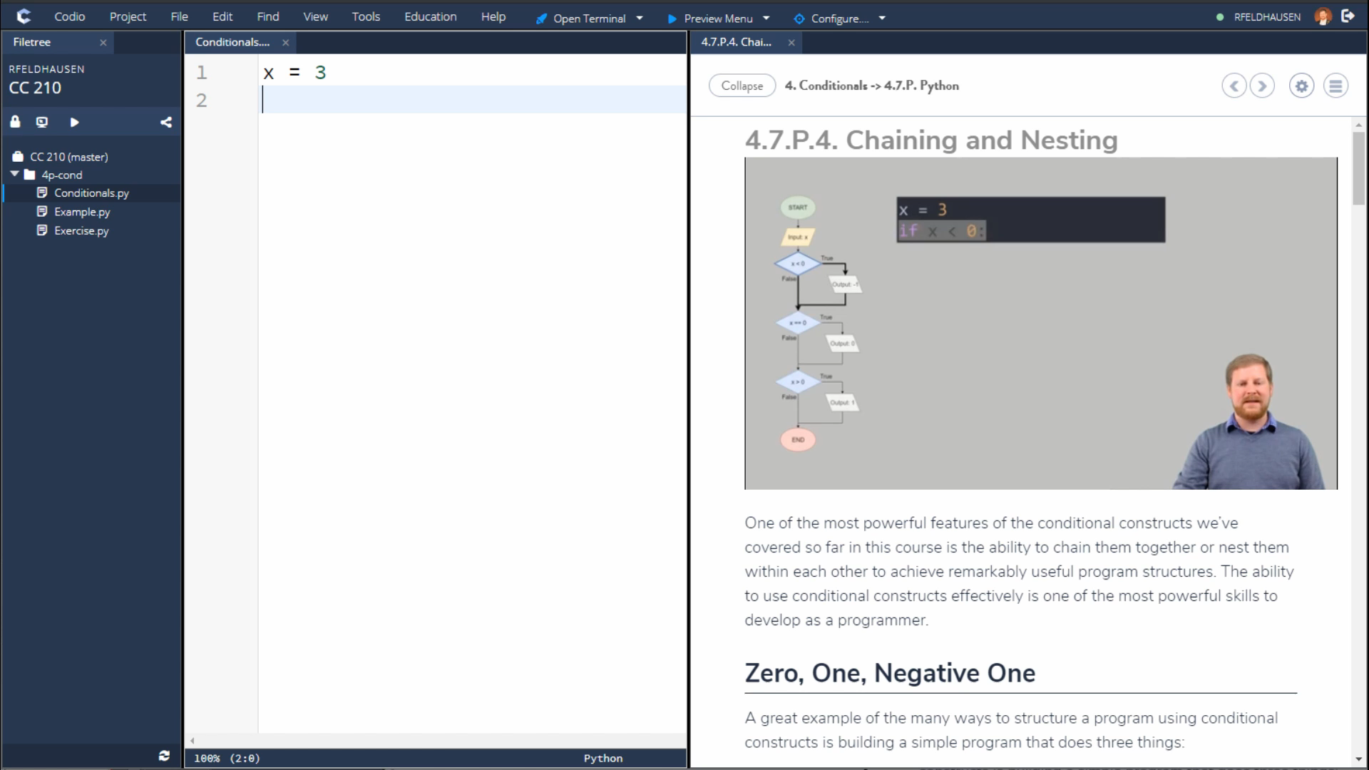
Notes:
We want to build that
Teach cs while being scalable
Follow tutorials and videos on right
Write code on left
Work directly in browser

Slide 10
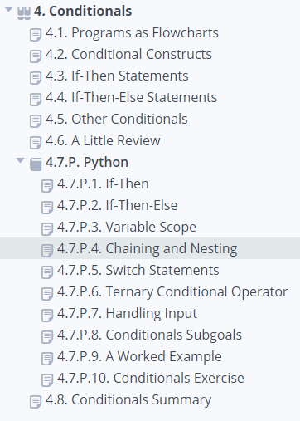
Small Lessons
Notes:
Small lessons, not omnibus lectures
Students can work at own pace
One module due each week

Slide 11
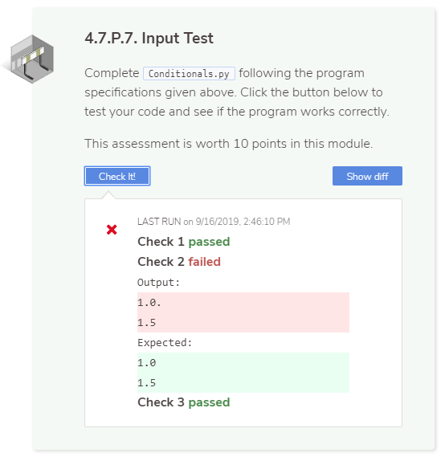
Instant Feedback
Notes:
Autograde programs to get feedback
Try and learn from mistakes

Slide 12
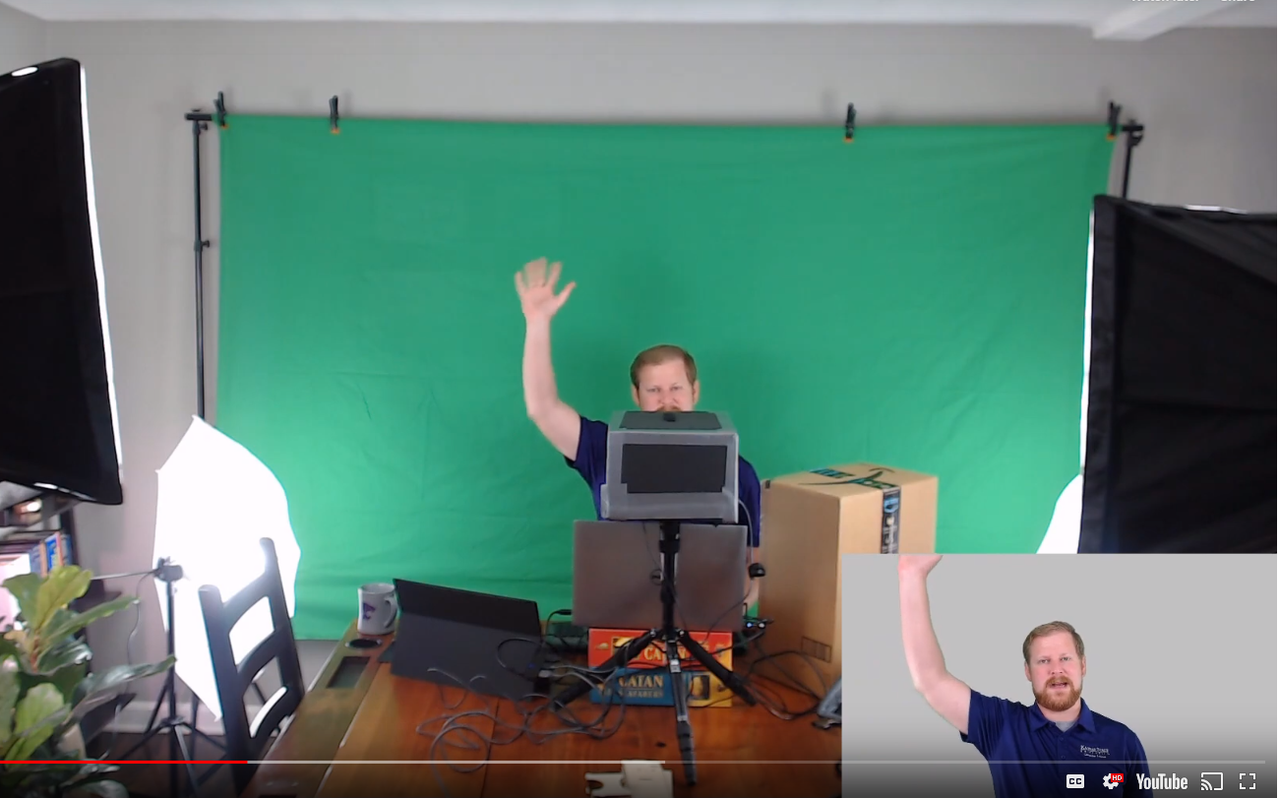
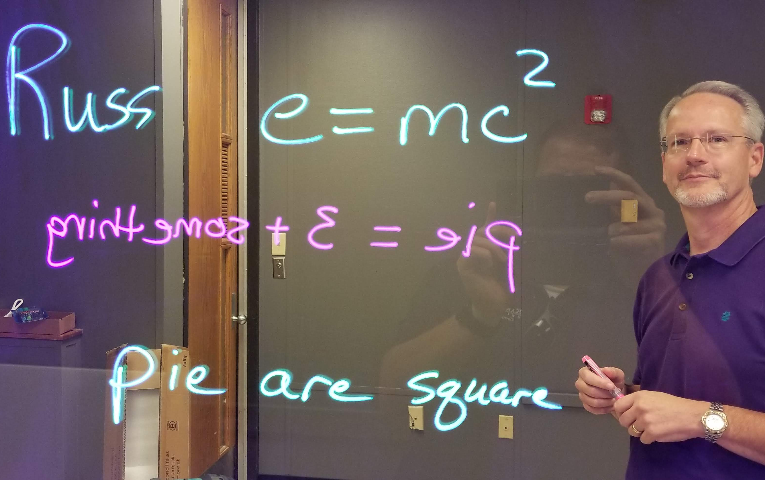
Develop & Engage
Notes:
5 classes, 2 faculty
Spend time developing material and engaging with students

Slide 13
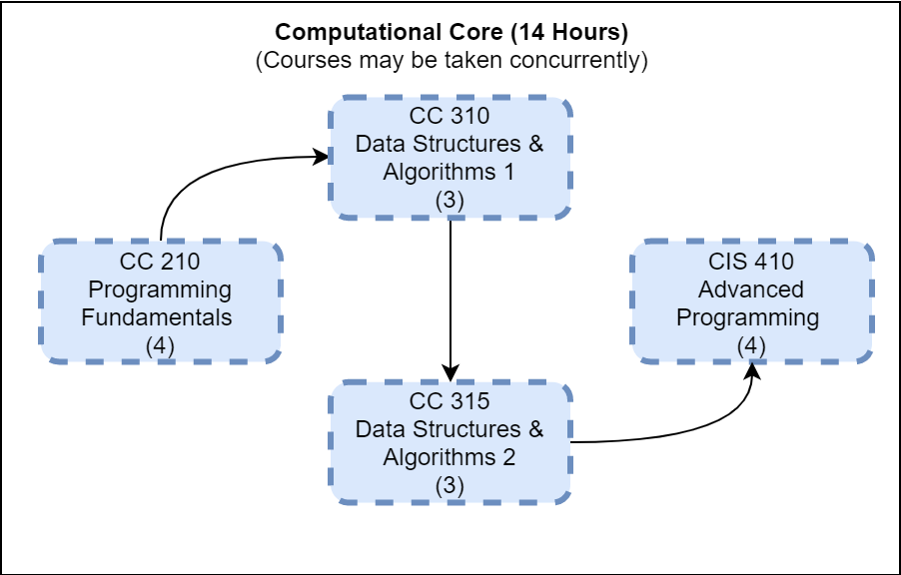
Customized Curricula
Notes:
Customize curricula to meet needs
Allow concurrent enrollment

Slide 14
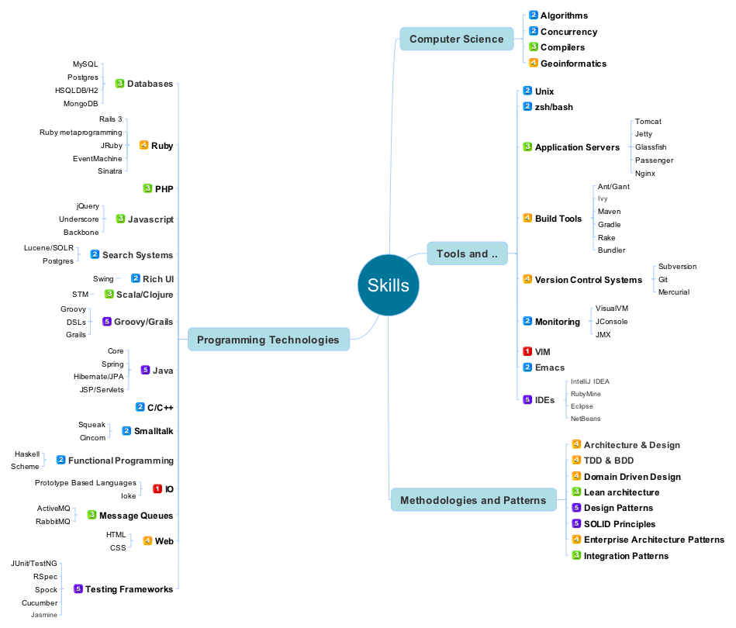
Individual Skills
Source: https://www.pixelstech.net/article/1327753273-30-Minute-Exercise-to-Become-a-Better-Programmer
Notes:
Do this by focusing on skill prerequisites instead of course prereqs

Slide 15
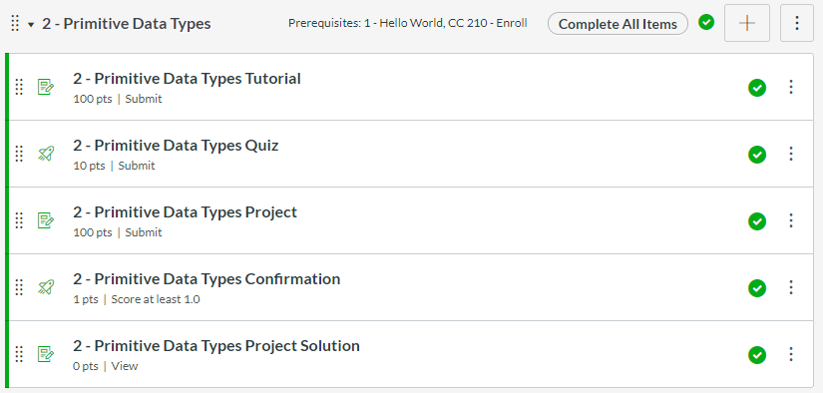
… using Modules & Prerequisites
Notes:
Can do this in Canvas already

Slide 16
Certificate Capstone Project
Identify Solvable Real World Problem
Select Data Structures & Algorithms
Implement Software to Specification
Debug & Test
Source: https://giphy.com/gifs/wolfram-research-data-visualization-3o6Ygfw40tlnPhX87m
Notes:
Bring it all together in a capstone
Drive learning outcomes
More faculty time here, less elsewhere

Slide 17

Available Today!
Computer Science Undergraduate Certificate
4 Courses, 14 Credits (5 courses, 17 Credits in Fall 2020)
Any K-State Student
Java or Python
100% Online
Designed for Non-CS Majors
FREE TRIAL!
Notes:
Available now!
Free trial

Slide 18
Possible Future Plans*
Applied Computer Science Degree (with Arts & Sciences)
High School Programs
Teacher Training Programs
Industry Certifications
Additional Programming Languages
Upper Level CS Courses
Cross-Discipline Capstone Projects
…and more!
*Subject to change – nothing is set in stone yet
Notes:
Many ways to expand these courses in the future.
Good return on investment

Slide 19
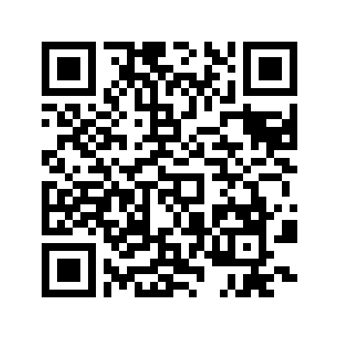
CC 210 Free Trial!
Russell Feldhausen
@russfeld
russfeld.me/talks/haveabyte2019
CS Certificate Promo Video
bit.ly/ksucs-cert-promo
More Information
global.k-state.edu/engineering/computer-science
cs.k-state.edu/core
Must be current K-State Student, Faculty, or Staff
Thank You!
Notes:
Sign up for free trial
Find me online @russfeld

